Slide 1
Navigating to the Onboarding Module Screen

Slide 2

Navigating to Onboarding Module Screen
To access the Onboarding Module:
1. Go to https://www.tcs.com.
2. Click Talent.
TCS Internal

Slide 3
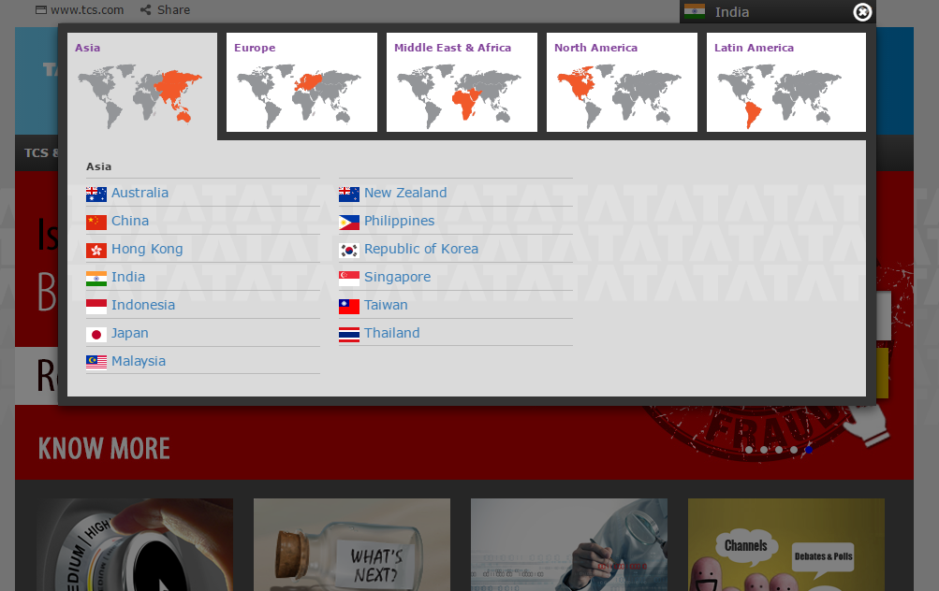
Navigating to Onboarding Module Screen
TCS Career Home page opens.
3. Select the tab for the desired Region.
4. Select Country.
TCS Internal

Slide 4


Navigating to Onboarding Module Screen
The Country Specific TCS Careers Home Page opens.
1. Go to https://www.careers.tcs.com
5. Go to Career Opportunities.
6. Click Experienced Professionals.
2. Click on Experienced Professional.
TCS Internal

Slide 5

Navigating to Onboarding Module Screen
Experienced Professionals (GRS) India home page opens.
6. Click Login.
TCS Internal

Slide 6

Navigating to Onboarding Module Screen
Click Register with Us if you are a New User.
7. Click Login if you are an Existing User.
TCS Internal

Slide 7
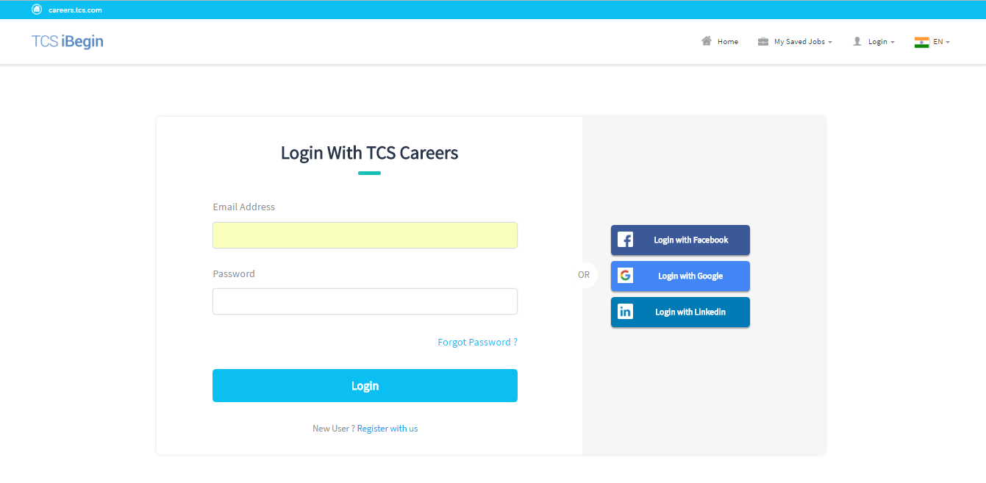
Navigating to Onboarding Module Screen
The GRS Login Page opens.
8. Provide Email Address and Password.
9. Click Login.
TCS Internal

Slide 8
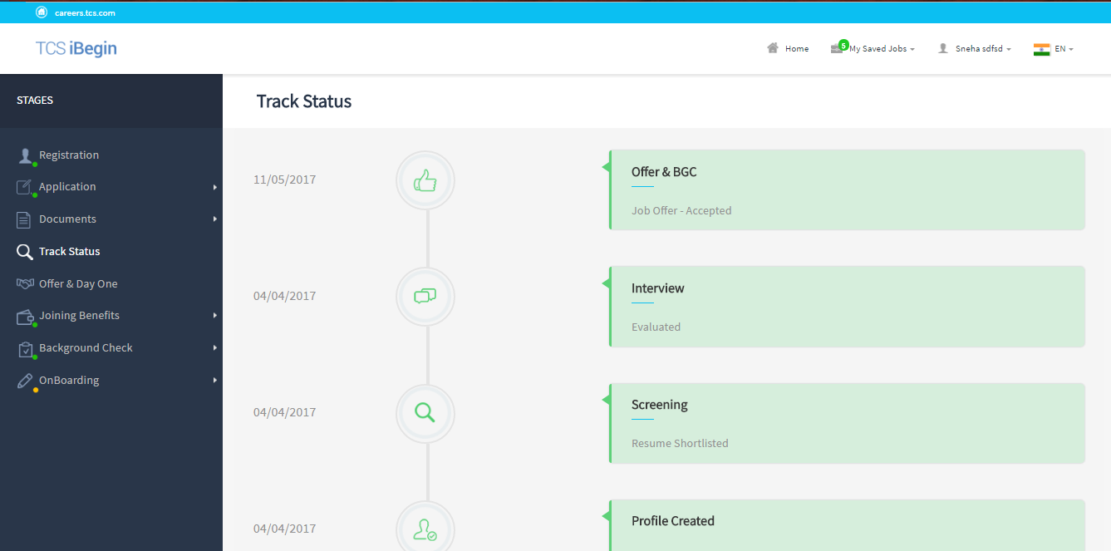
Navigating to Onboarding Module Screen
The Track Status page opens.
10. Click OnBoarding.
TCS Internal

Slide 9
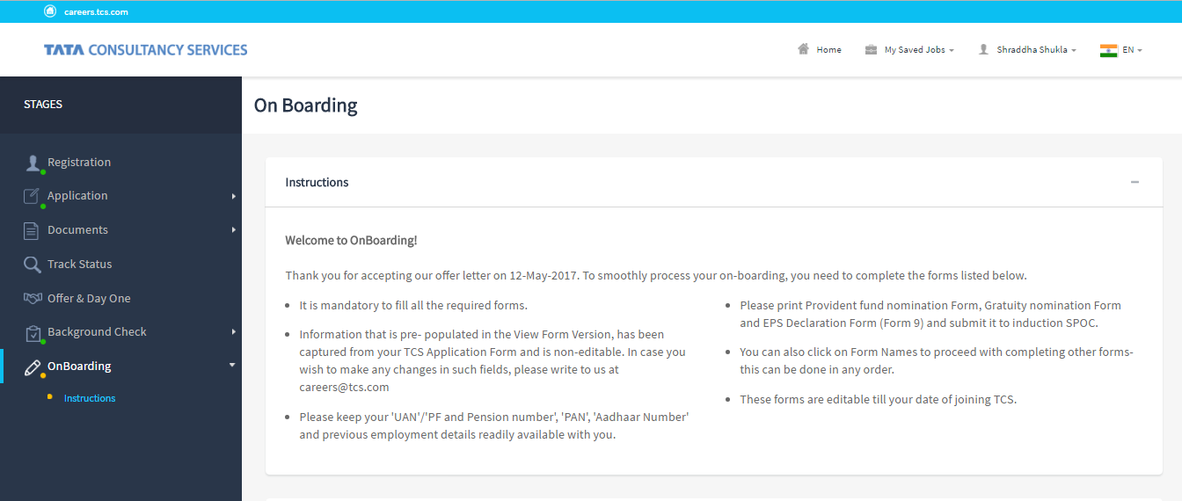
Navigating to Onboarding Module Screen
The On Boarding page opens.
TCS Internal

Slide 10
Providing Details for the Instruction Section

Slide 11
Providing Details for the Instruction Section
1. Repeat steps from the section Navigating to the Onboarding Module Screen.
2. Click Instructions.
TCS Internal

Slide 12
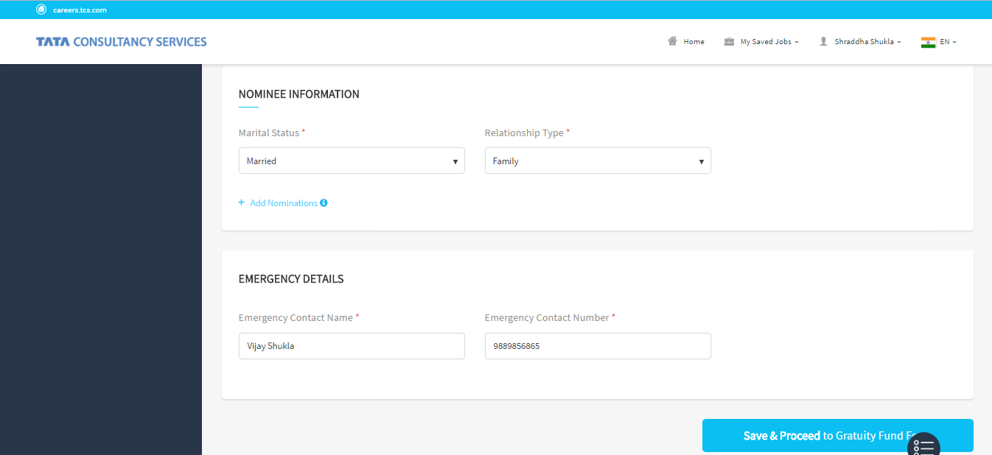
Providing Details for the Instruction Section
The NOMINEE INFORMATION page opens.
3. Select your Marital Status and Relationship Type of your nominees
4. Click Add Nominations.
TCS Internal

Slide 13
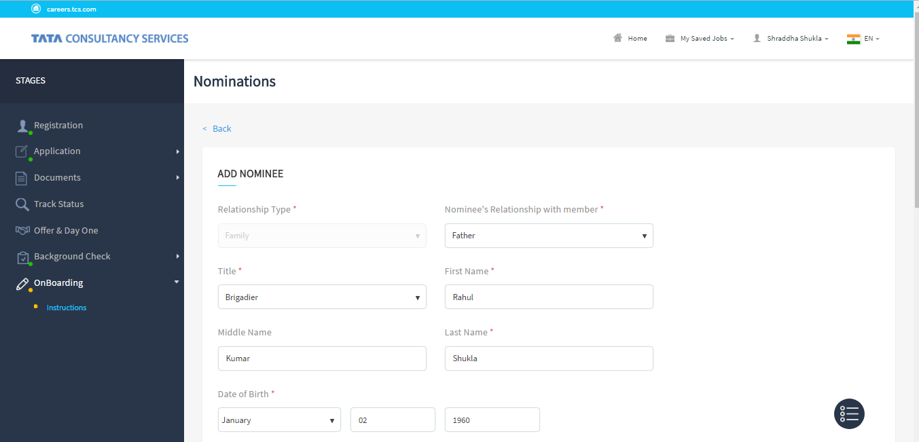
Providing Details for the Instruction Section
The Nomination Form opens.
Click Back to go back to the Instruction screen.
5. Select Nominee’s Relationship with member.
6. Provide Relationship Type, Title, First Name, and Last Name.
7. Provide Date of Birth for Non-Minor Nominee.
TCS Internal

Slide 14
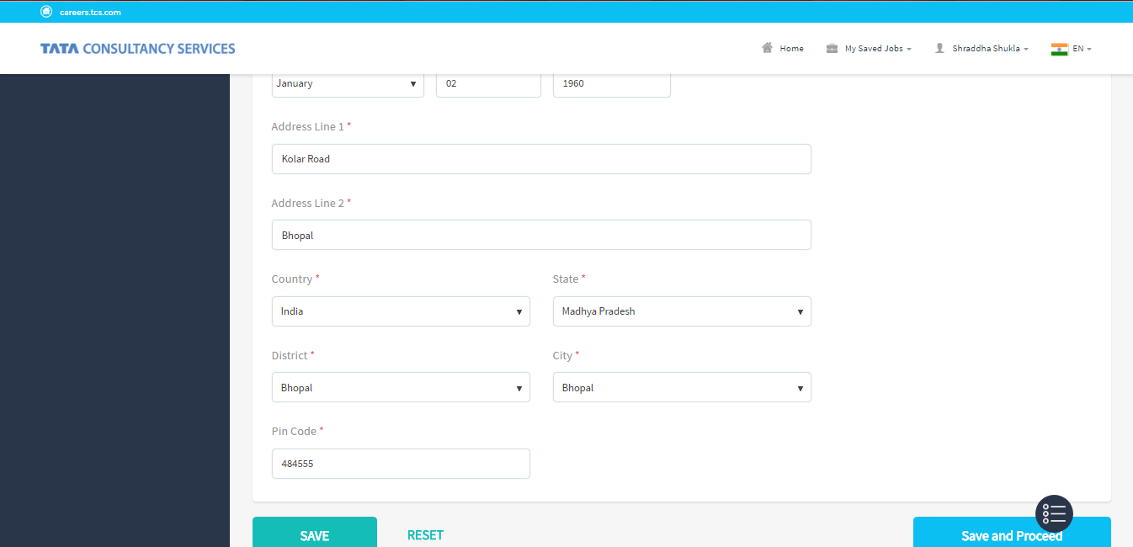
Providing Details for the Instruction Section
7. Click Save.
OR
click Reset to change the Nomination details.
TCS Internal

Slide 15
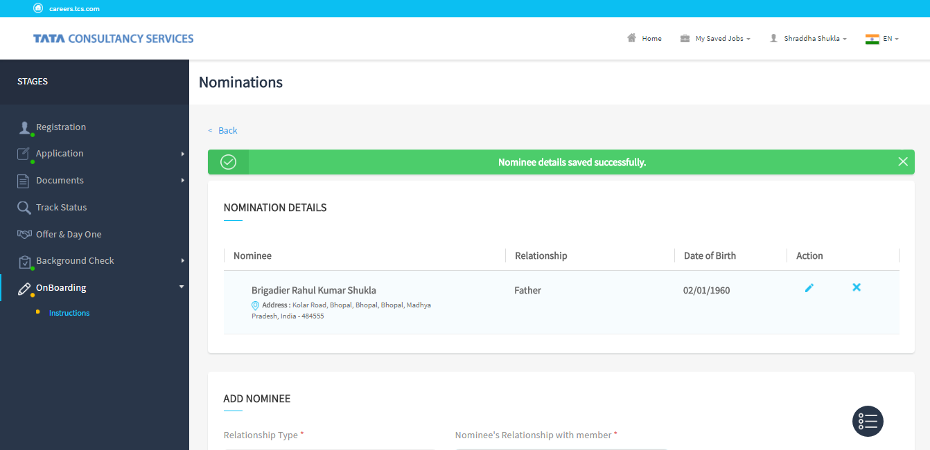
Providing Details for the Instruction Section
A success message opens
Click Edit or Delete to alter the Nominee details.
TCS Internal

Slide 16
Providing Details for the Instruction Section
Nomination Form opens
8. Repeat steps 1 to 6 from Providing details for the Instruction Section.
9. Provide Date of Birth.
TCS Internal

Slide 17
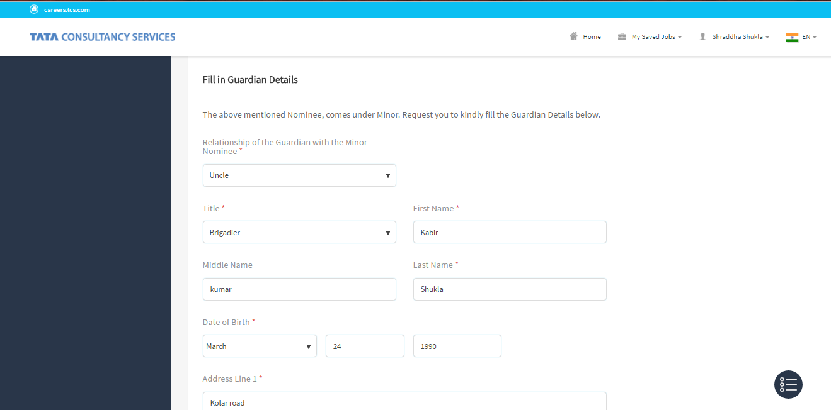
Providing Details for the Instruction Section
Minor Nomination Form asking for Guardian’s details appear.
11. Provide the Title, First Name, and Last Name.
10. Select Relationship of the Guardian with the Minor Nominee.
TCS internal

Slide 18
Providing Details for the Instruction Section
Minor Nomination Form asking for Guardian’s details appear.
12. Click Save.
OR
Or click Reset to change the Guardian details.
TCS Internal

Slide 19
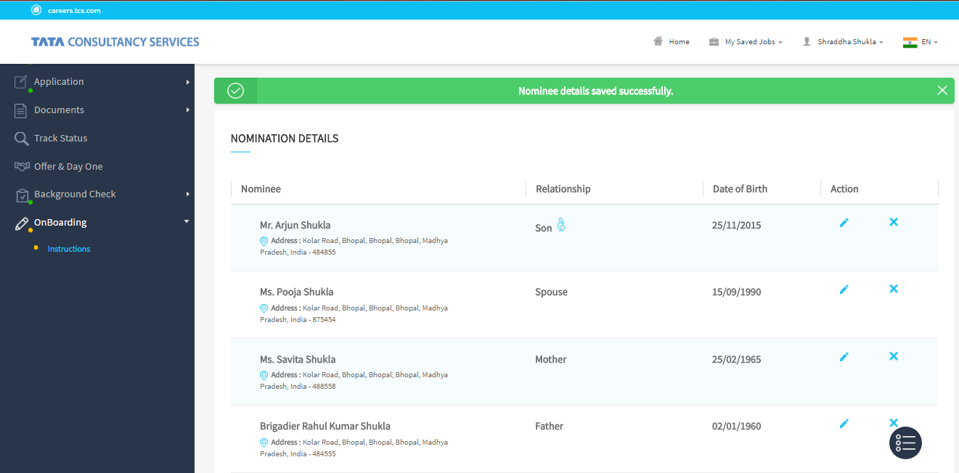
Providing Details for the Instruction Section
A success message opens
Click Edit or Delete to edit or delete the Nominee details.
TCS Internal

Slide 20
Providing Details for the Instruction Section
Minor Nomination Form asking for Guardian’s details appear.
13. Repeat steps from Providing Details for the Instruction Section.
14. Click Save and Proceed.
TCS Internal

Slide 21
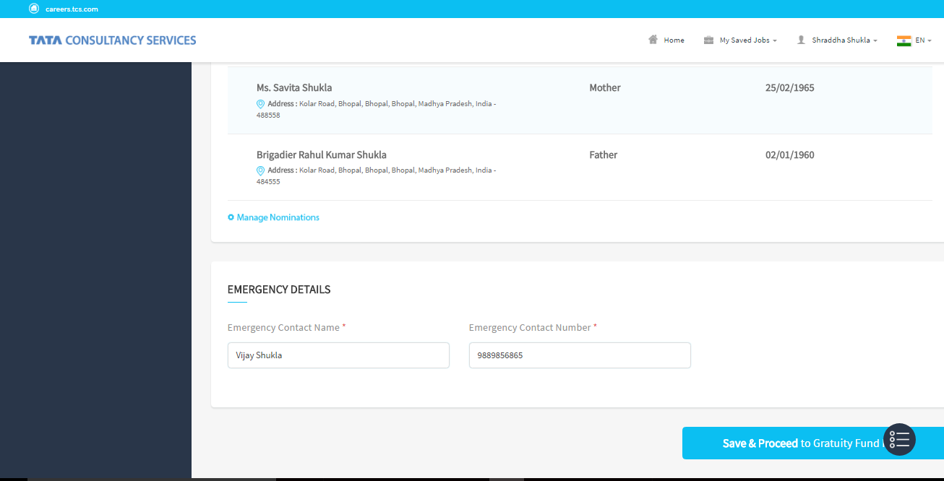
Providing Details for the Instruction Section
The Instruction page opens.
14. Provide Emergency Contact Name and Emergency Contact Number.
15. Or Click Manage Nomination to change the Nomination details.
15. Click Save & Proceed to Gratuity Fund.
TCS Internal

Slide 22
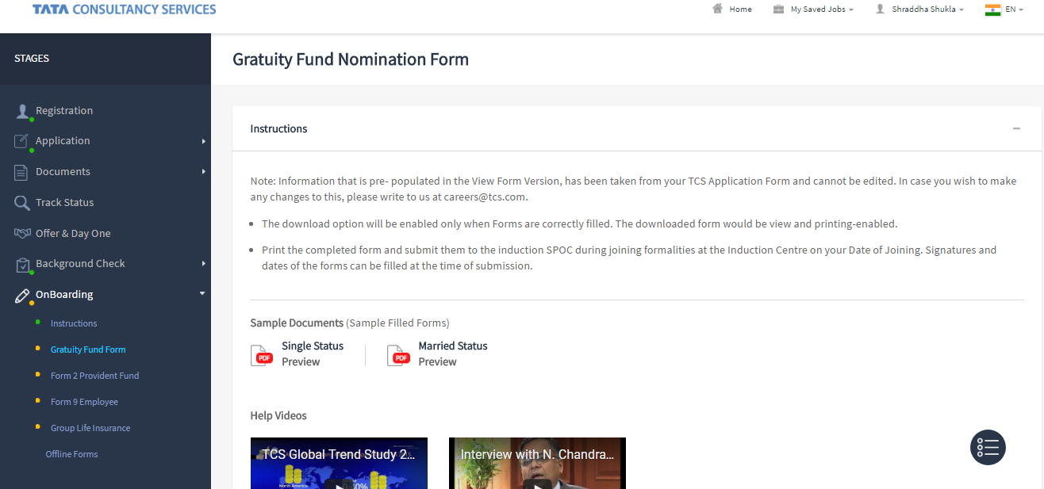
Providing details for the Gratuity Fund Form
The Gratuity Fund Nomination Form opens.
TCS Internal

Slide 23
Providing Details for the Gratuity Fund Form

Slide 24
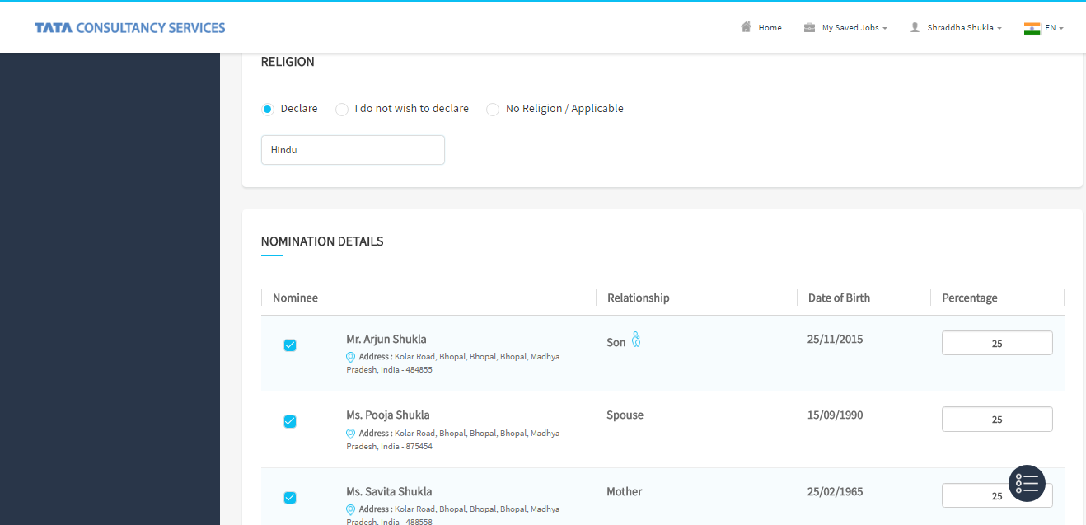
Providing Details for the Gratuity Fund Form
The Gratuity Fund form opens.
1. Select Religion.
3. Provide Percentage.
2. Click the Nominee checkbox.
TCS Internal

Slide 25
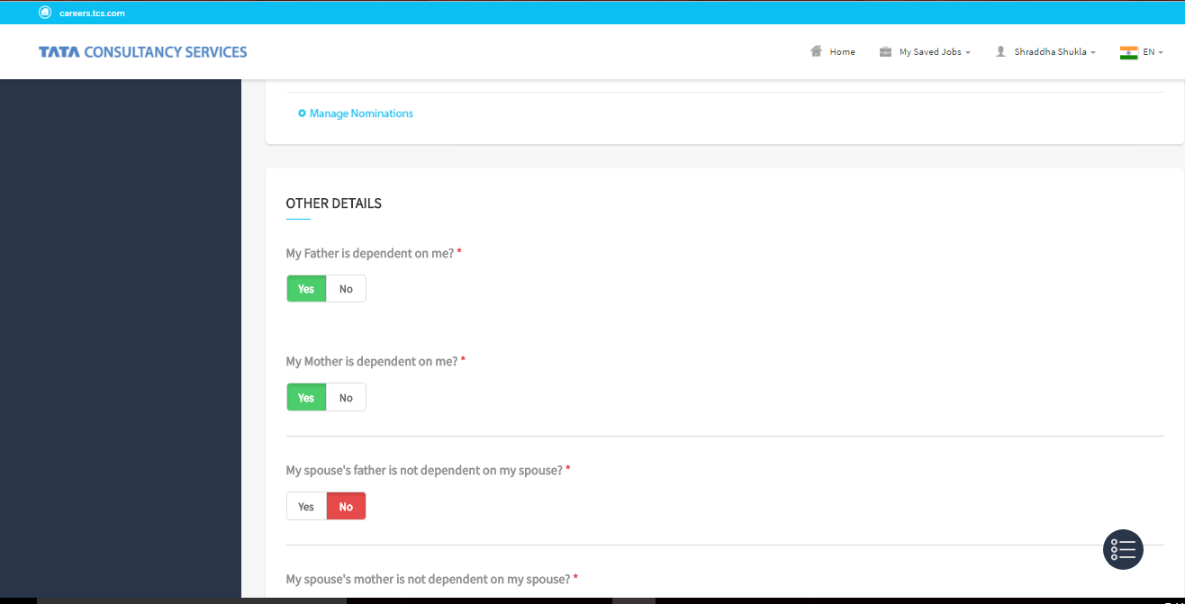
Providing details for the Gratuity Fund Form
The Gratuity Fund form opens
5. Or Click Manage Nomination to change the Nomination details.
5. Click the Yes/No toggle switch marked with *.
TCS Internal

Slide 26
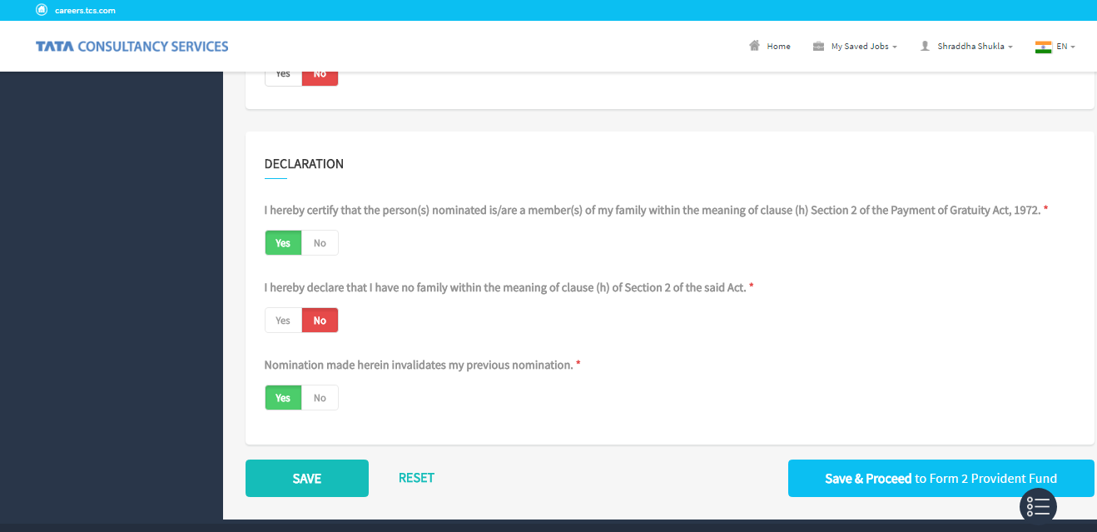
Providing Details for the Gratuity Fund Form
The Gratuity Fund form opens
6. Click Save & Proceed to Form 2 Provident Fund form.
TCS Internal

Slide 27
Providing Details in the Provident Fund Form

Slide 28
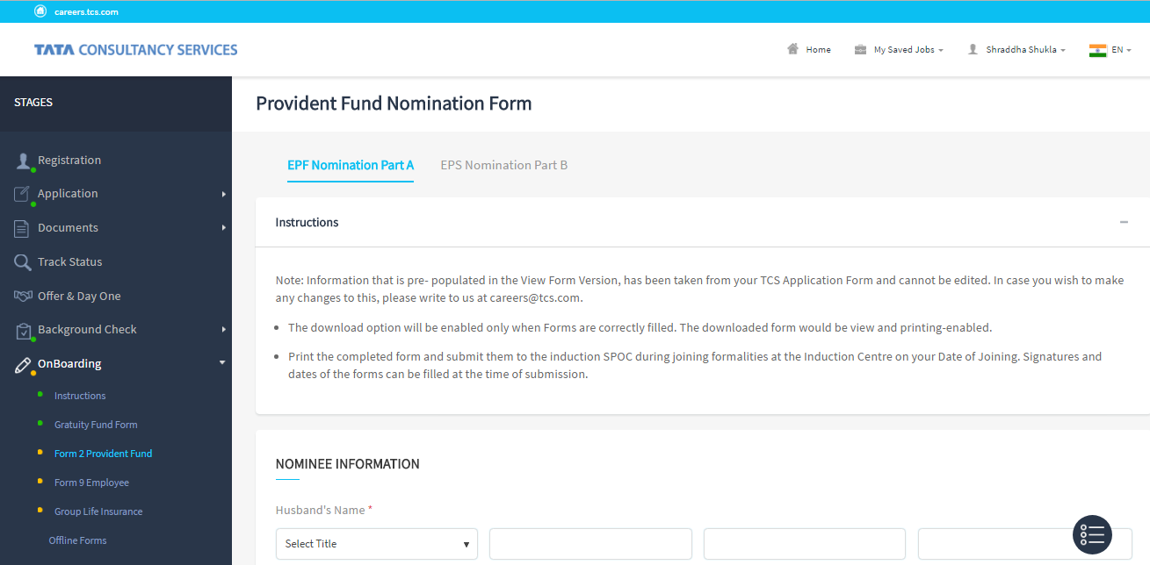
Providing Details in the Provident Fund Form
The Provident Fund Nomination form Part B opens
1. Provide Husband’s Name (Appears only when the Gender is Female and Marital Status is Married).
TCS Internal

Slide 29
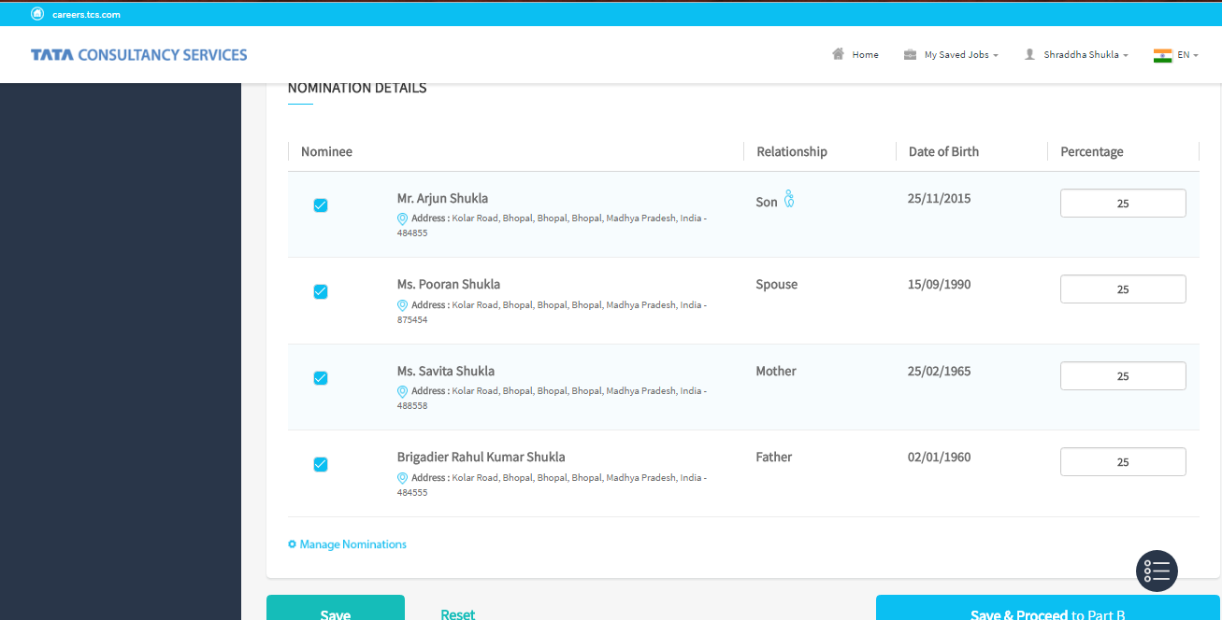
Providing Details in the Provident Fund Form
The Provident Fund Nomination form Part B opens.
3. Provide Percentage.
2. Select the Nominee checkbox.
Click Manage Nomination to add or edit the Nomination details.
4. Click Save & Proceed to Part B.
TCS Internal

Slide 30
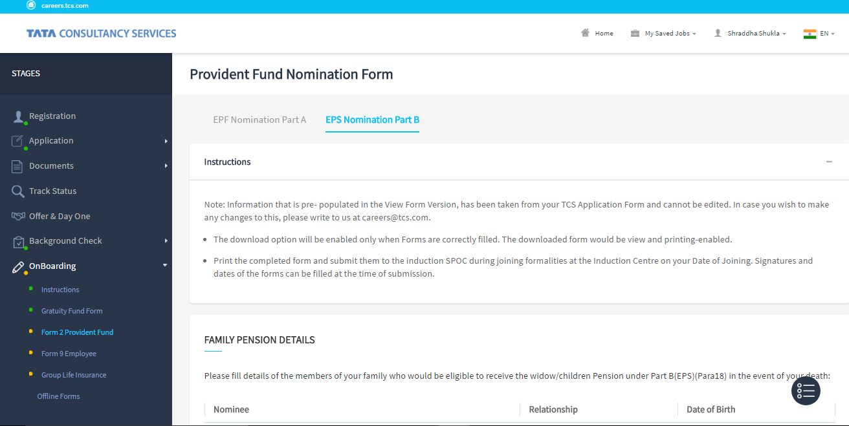
Providing Details in the Provident Fund Form
The Provident Fund Nomination form Part B opens
4. OR Click EPF Nomination Part A to go back.
TCS Internal

Slide 31
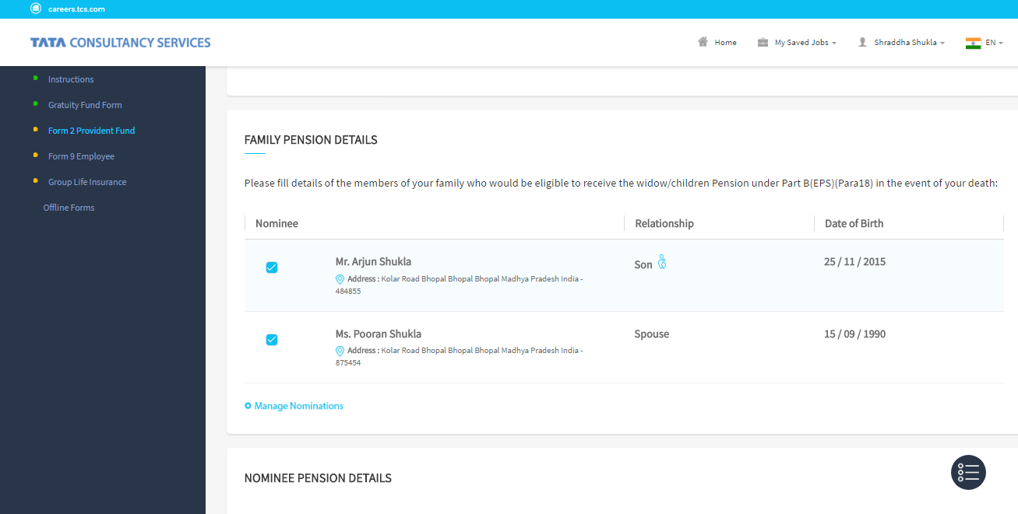
Providing Details in the Provident Fund Form
The Provident Fund Nomination form Part B opens
1. Select the Family Pension checkbox.
Click Manage Nomination to change the Nomination details.
TCS Internal

Slide 32
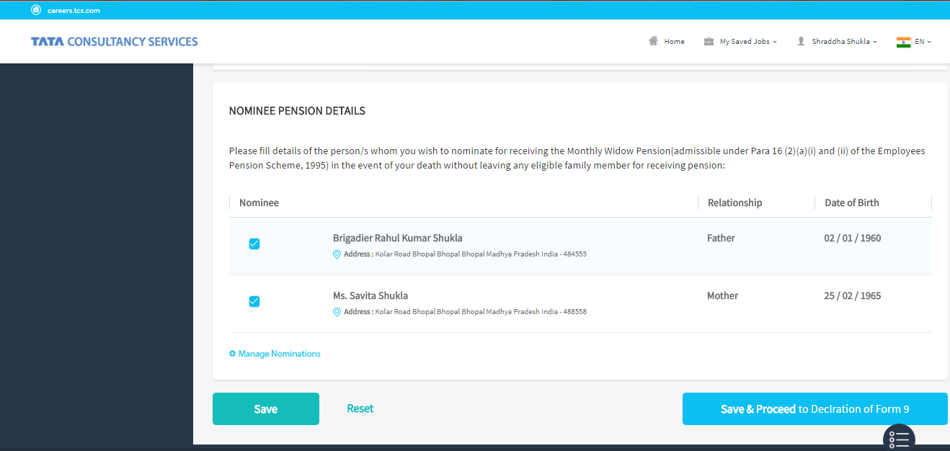
Providing Details in the Provident Fund Form
The Provident Fund Nomination Form Part B opens.
2. Select Nominee checkbox.
3. Click Save & Proceed to Declaration of Form 9.
TCS Internal

Slide 33
Providing Details in the Declaration Form 9

Slide 34
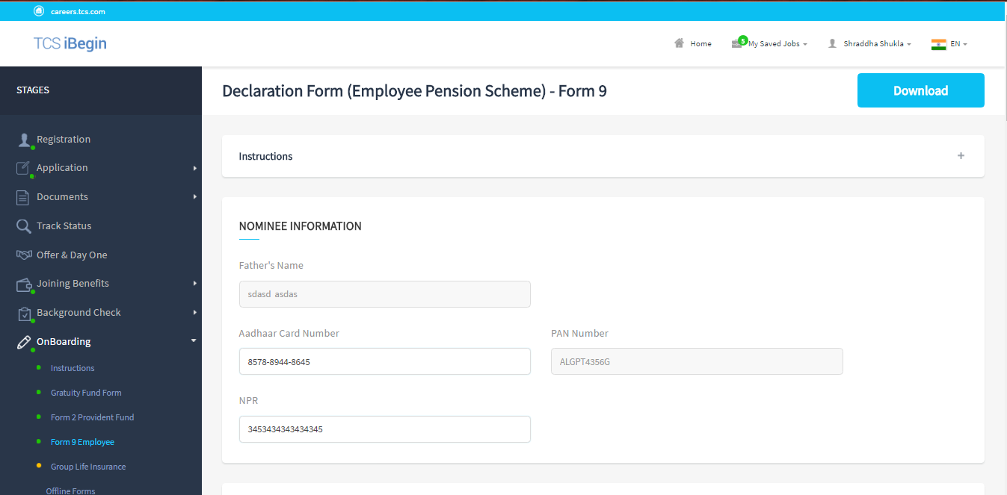
Providing Details in the Declaration Form 9
The Declaration form (EPS) Form 9 opens.
1. Provide Aadhaar and NPR Detail.
TCS Internal

Slide 35
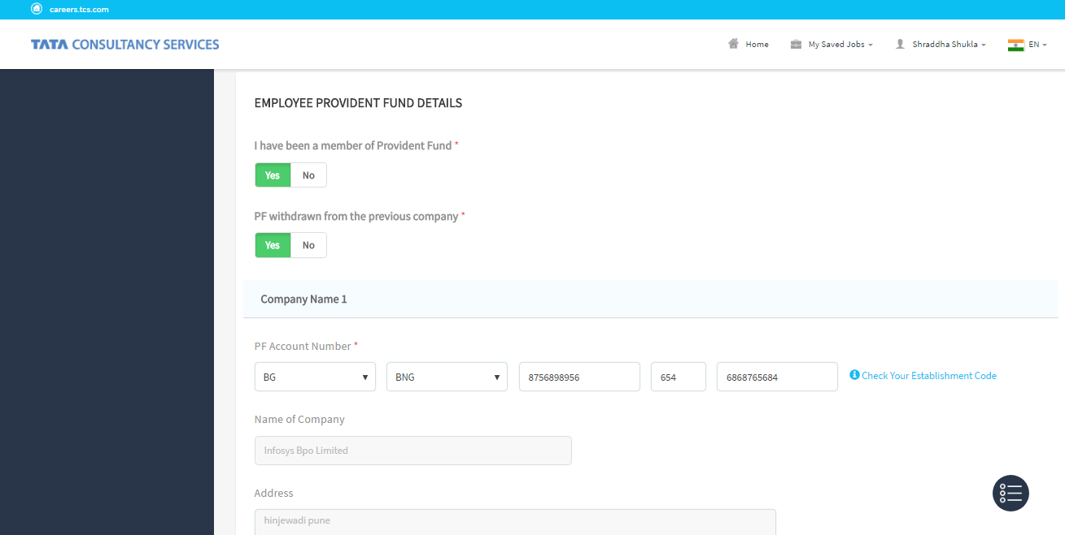
Providing Details in the Declaration Form 9
The Declaration form (EPS) - Form 9 opens
2. Click the Yes/No toggle switch marked with *.
3. Provide PF Account Number of Company Name 1.
Check Your Establishment Code will help the user to check account related code.
TCS Internal

Slide 36
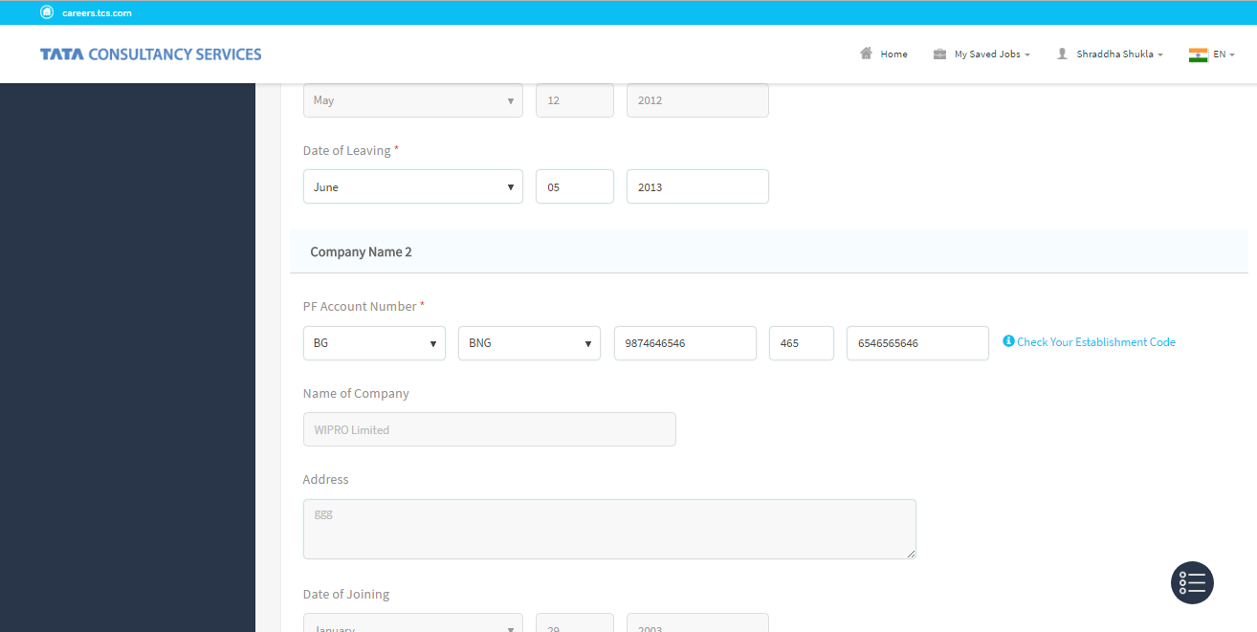
Providing Details in the Declaration Form 9
The Declaration form (EPS) Form 9 opens.
4. Provide PF Account Number of Company Name 2.
TCS Internal

Slide 37
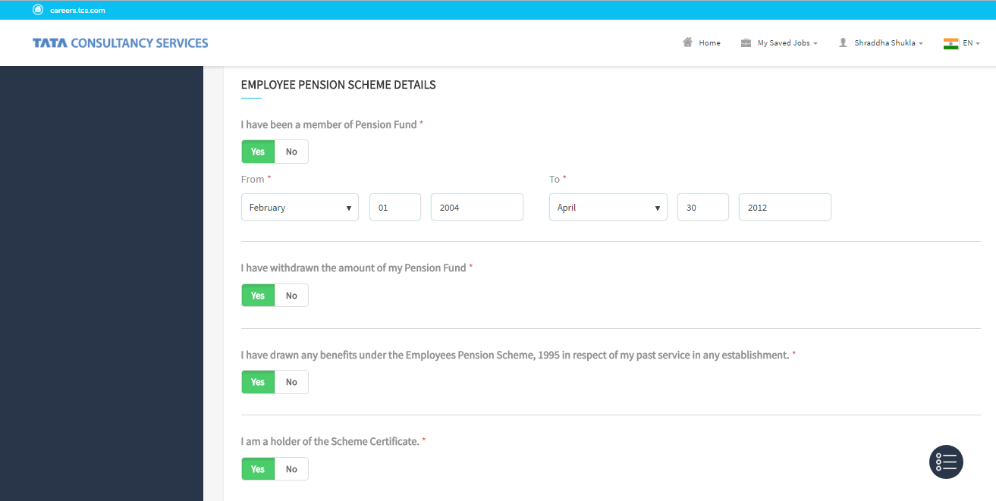
Providing Details in the Declaration Form 9
The Declaration form (EPS) - Form 9 opens
5. Click Yes/No toggle switch.
6. Provide Duration of Pension fund.
7. Click mandatory Yes/No toggle switch marked with *.
TCS Internal

Slide 38
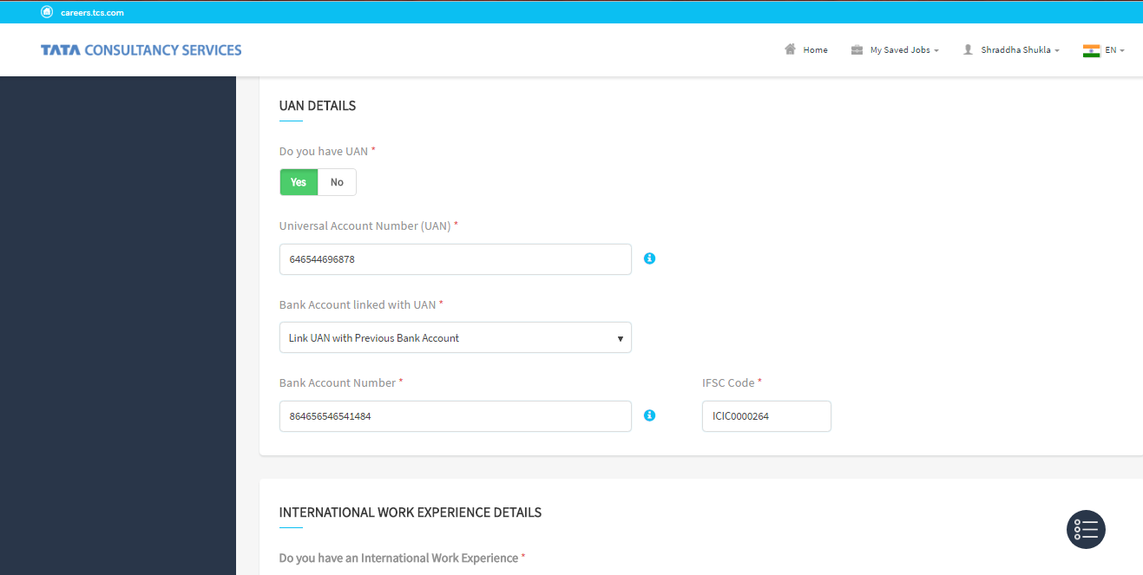
Providing Details in the Declaration Form 9
The Declaration form (EPS) - Form 9 opens
8. Select the Yes/No toggle switch for UAN details.
9. Select Bank account detail linked with UAN.
TCS Internal

Slide 39
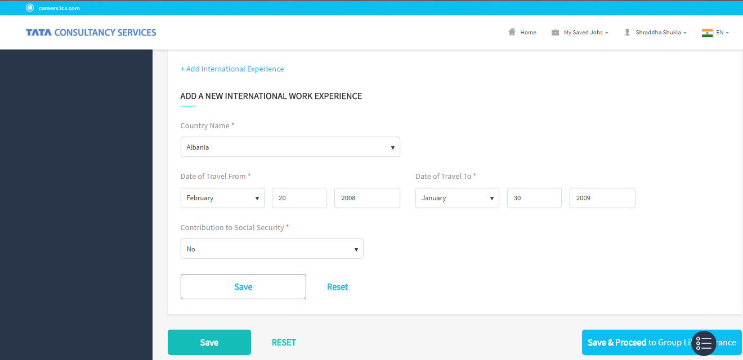
Providing Details in the Declaration Form 9
The Declaration form (EPS) - Form 9 opens
10. Provide International Work Experience.
11. Click Save.
12. Click Save & Proceed to Group Life Insurance.
TCS Internal

Slide 40
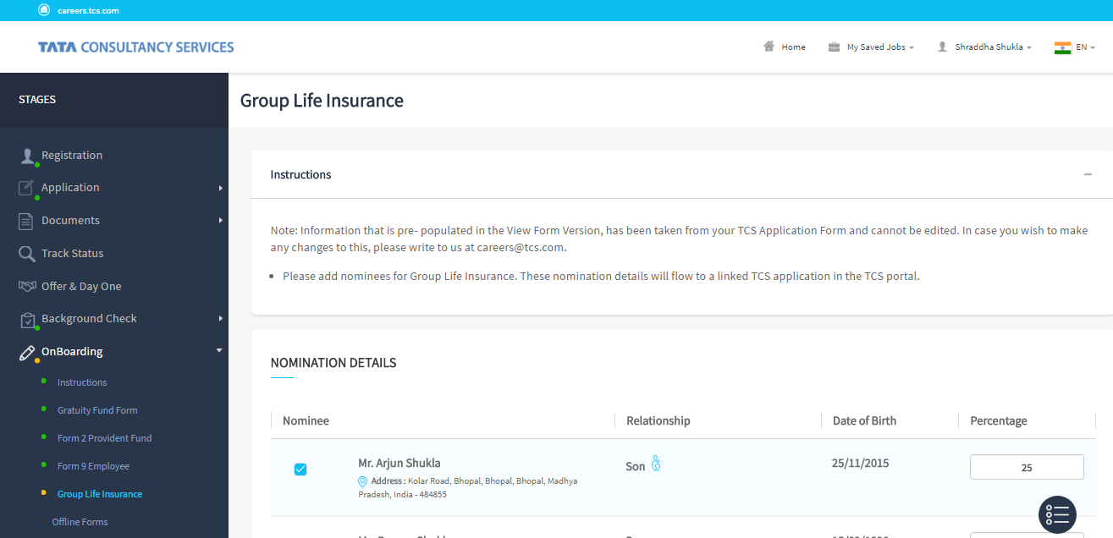
Providing Details in the Declaration Form 9
The Group Life Insurance form opens.
TCS Internal

Slide 41
Providing Details in the Group Life Insurance Form

Slide 42
Providing Details in the Group Life Insurance Form
The Group Life Insurance form opens.
1. Select the Nominee checkbox.
2. Provide Percentage.
TCS Internal

Slide 43
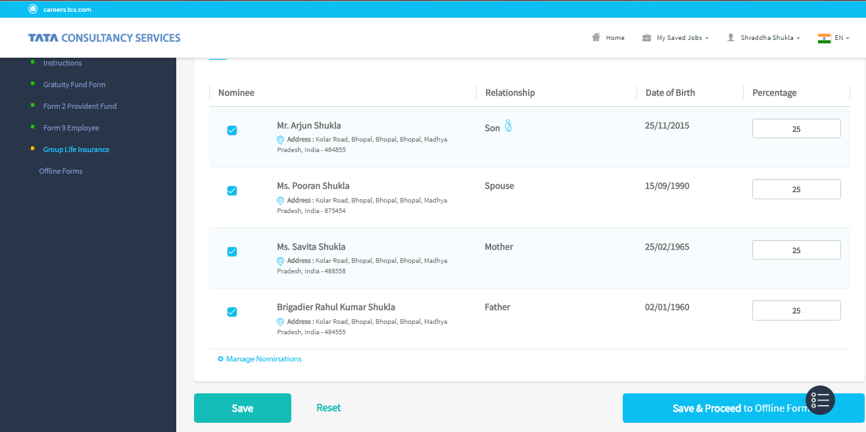
Providing Details in the Group Life Insurance Form
The Group Life Insurance form opens
3. Click Save & Proceed to Offline form.
TCS Internal

Slide 44
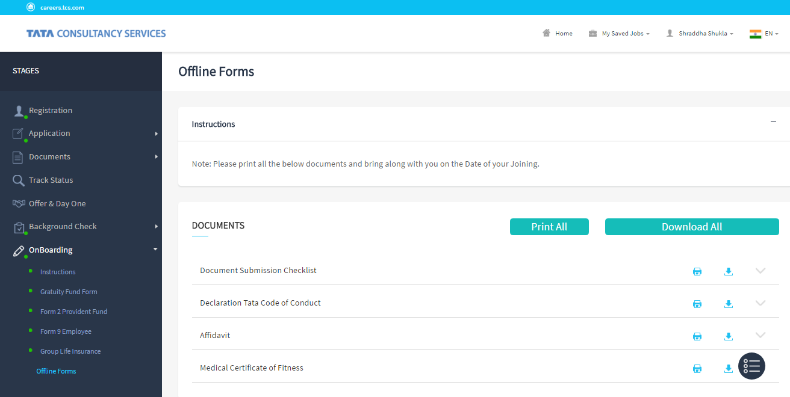
Providing Details in the Group Life Insurance Form
The Offline Forms opens
TCS Internal

Slide 45
Printing or Downloading Offline Forms

Slide 46
Printing or Downloading Offline Forms
The Offline Form opens
2. Click Download All button.
1. Click Print All to print offline forms.
Click Download and Print icon individually.
TCS Internal

Slide 47
Thank You

